Slide 1
Analog Communications
Signals and Communication Systems (24EC2105)

Slide 2
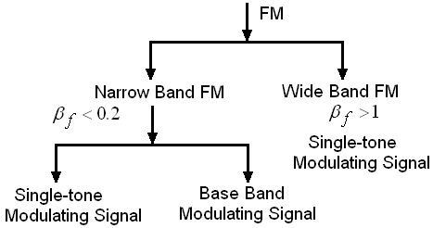

Slide 3
Wideband FM

Slide 4
Single-tone Wideband FM
where J_{n}(β_{f}) is a Bessel function of the first kind of n th order with argument β_{f}.
an even, periodic function
an odd periodic function

Slide 5
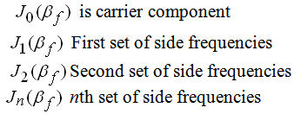
Wideband FM…

Slide 6
Spectrum of WBFM
The carrier with amplitude
A set of side frequencies specified simultaneously on the either side of the carrier at a frequency separation of

Slide 7
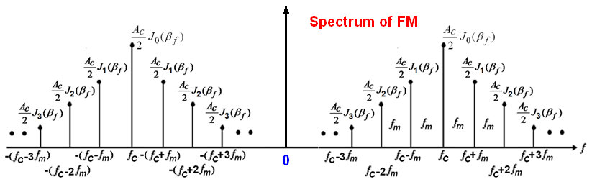

Slide 8
Bandwidth of FM
Band width of NBFM.
Bandwidth of WBFM
Band width of FM based on the frequency deviation.
Band width of FM based on the number of significant sidebands.
Band width of FM based on the Carson’s rule.

Slide 9
Band width of NBFM
Same as AM.
NBFM: B.W = 2f_{m}

Slide 10
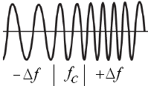
Band width of FM based on the frequency deviation.

Slide 11
Band width of FM based on the number of significant sidebands
The actual bandwidth required to pass all the significant sidebands

Slide 12
Carson’s Rule
Band width of FM based on the Carson’s rule
The Carson rule state that the approximate bandwidth necessary to transmit an angle modulated wave as twice the sum of the frequency deviation and the highest modulating signal frequency.
Approximates the 98% of total power.
Carson’s BW is less than actual Transmission BW.

Slide 13
Effect of the Modulation Index on Bandwidth
The Carson’s rule

Slide 14
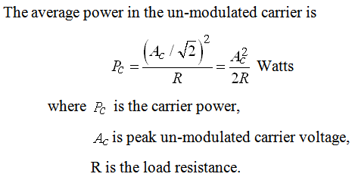
Average Power of an Angle Modulated Wave

Slide 15
End WBFM

